Slide 1

Insights From Customer Reviews
Obinna Oliseneku

Slide 2

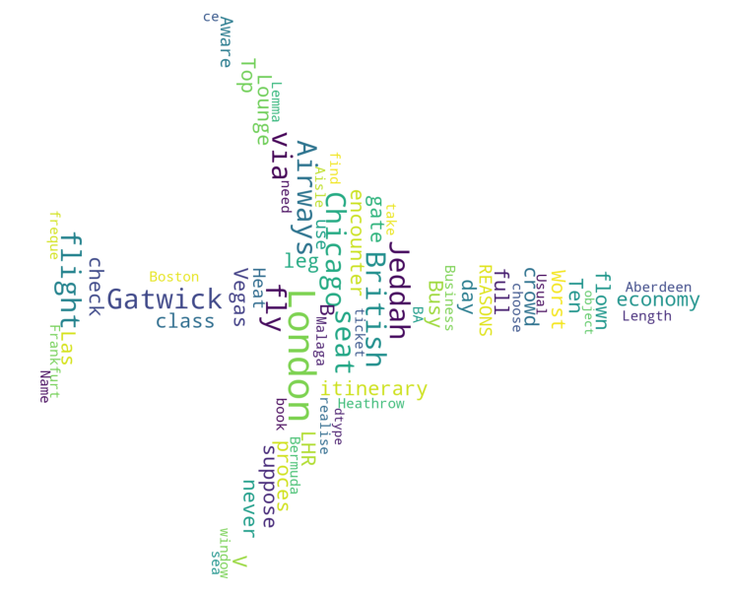
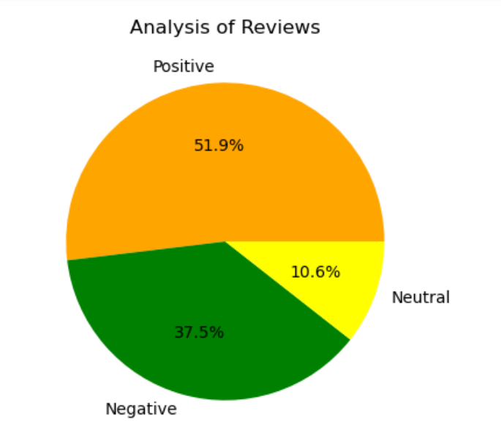
Insights from web scrapping
From cleaning 1000 reviews given by the customers, we obtained
Positive Reviews - 519
Negative Reviews - 375
Neutral Reviews – 106
Word cloud showing keywords used in reviews

